Slide 1

Frankie Bleau

Slide 2
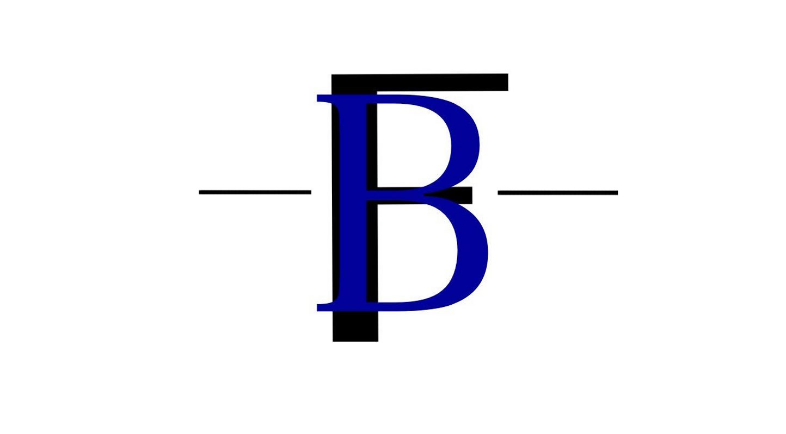

Slide 3
Copyright 2016 © by Justin Jordan
All rights reserved. This book or any portion thereof may not be reproduced or used in any manner whatsoever without the express written permission of the publisher except for the use of brief quotations in a book review.
ISBN 9766-o0-98964403-1-1
Bleau Enterprises Publishing
Atlanta, GA 30349
www.frankiebleau.com

Slide 4

Table of Contents
Introduction…............... 5
Chapter I…............... 6
Chapter II…............... 21
Chapter III…............... 28
Conclusion…............... 36

Slide 5

INTRODUCTION
Frankie Bleau
Simple instructional to tapping your true Personal Style.

Slide 6
Chapter I
IDENTITYfying
Finding what Style you like vs. What style likes you
The Gentleman
You’ve been watching the latest music videos, stalking that new rappers Instagram, even took a Fashion Style for Dummies quiz, and still nothing! So now you’re here, with the gay guy that mixes women’s clothes giving advice about how to be a “Gentleman.” Yea, I know right?
WAIT…. before you stop reading, just think, what does almost every gay guy have, that you want? The designer looks that we be so “fresh” in, oh, and not to mention all the pretty girlfriends that I have, getting all the inside on what they like to go down they DM’s, okay.
*waits for you to finish laughing and saying, “Damn, he’s right.”*
Ready now?

Slide 7
Frankie Bleau
With six simple steps:
  Getting Personal
  Knowing Your Surroundings
  Find Your Style Comfort Level
  Getting Personal
  Knowing Your Surroundings
  Find Your Style Comfort Level
I’m going to show you how to recognize the immaculate style that you’ve been longing to tap into, and hope to imagine the reactions on your faces when you realize just how easy it is to be sky fly! The best part about it all is that it’ll be tailored for only you.
Within these steps you’re going to tunnel on the key concepts when evaluating your personal style in the current vs. the possible. Together, we’re going to aggressively narrow a philosophy specifically for you that is going to create a day-to-day guide on how to perfectly polish your look. Now I know you’re probably thinking “When did it become a science to dress well?”, and you’re absolutely right! It’s not hard at all! Especially when you’re the creator. It’s a cakewalk. Although you don’t want to be dressed like a skateboarder walking into your job as a broker, ya know?

Slide 8
The Gentleman
In Chapter 1, we’re going to focus on the first 3 Steps:
  Getting Personal
  Knowing Your Surroundings
  Find Your Style Comfort Level
The key mechanism to this all is IDENTITYfying. IDENTITYfying is just my spin on identifying your identity. Now no, I’m no psychologist or life healer, but I do know in order to do something great you must know yourself and the purpose. Particularly in this aspect, fashion wise, what you like and dis-like vs. what like and dis-likes you-
Bringing us to Step 1: Getting Personal.
Whenever you shop, you automatically shop for what you know works and will look good on you. You should always be in accordance with your look, otherwise it’ll never be complete. Discomfort will always show far more than excitement most times.

Slide 9
Frankie Bleau
With that being said, ask yourself three questions:
  Where am I now (in life, not literally)?
  What is my current job?
  What is my career goal?
  Does your current style reflect answers 1-3?
Next, asses yourself:
Asking yourself these 3 easy questions, honestly, will help you with determining everything from your new style budget to locating your go-to piece.

Slide 10
The Gentleman
For example my answers:
The in between stage of living life and figuring it out.
Hospitality Welcome Agent/Men’s Style Concierge.
Style/Entertainment Architect.
Somewhat.
And just like that, with 3 simple questions I’ve already created a visual on a couple of styles that will fit me. Even if you don’t identify a specific style, or even a piece, that will immediately correlate with your answers that’s fine. In the beginning we’re only realizing. Again, the key is being honest with yourself. Know that the only one benefiting is you, and of course whoever your woo’ing. Your answers don’t have to have to be long nor short, but the more detail the better for you.
Getting Personal can be tough if you don’t recognize exactly what it may be that you want to magnify, so make sure going into it you have a clear view and understanding.
You can get a better view on different Styles Here.

Slide 11
Frankie Bleau
Now, reflecting on your answers I’m sure you’re already creating a new vision for yourself. Questions like these are vital for any circumstance, even beyond personal style situations, because they allow you to focus on a certain point within yourself with honesty. Self-Analysis is the number one way to fix internal or even external attributes that you think requires correction. Who else knows you better than yourself?
One thing I noticed after completing my brief questionnaire were daily task that I did. Directing me to Question 4’s answer, “somewhat”. Not an answer that you’d expect from a professional, huh? But through being honest with myself, I was easily able to adjust to-
Step 2: Knowing Your Surroundings.
Knowing Your surroundings is extremely fundamental with INDETITYfying. It enhances your senses, enabling you to recognize, and reveal, aspects to further your personal style. With knowing your surroundings, you adapt and become one with who you truly are.

Slide 12
The Gentleman
To know your surroundings you must identify your everyday. For example- 3 main things I focus on are:
  The current project I’m working on/current job.
  My Direct circle of friends.
  My home environment.
The three main things that you choose to focus on doesn’t have to be identical to mine. Whatever you feel like affects your daily mood and/or routine is what you’d qualify as your surroundings. Pinpoint those three things and begin to analyze. Is there anything you’d like to change? Anything you’d like to enhance? Or should you just start completely over from scratch?
Once identified, proceed to detail those 3 pinpoints.

Slide 13
Frankie Bleau
Home Environment. What you are surrounded by daily will reflect in your physical appearance. Whether you recognize it or not, someone will. If your home is full of sports magazines and empty beer bottles, nine times out of ten your closet is going to be slightly full of varsity jackets, jeans, and a couple of tee-shirts. If you work in a corporate setting, you probably dread it. It isn’t a true representation of your true style. This is why it is very important to recognize your personal style. Grandma was right when she tells you it starts at home.
The best way to better your current circumstances is a more detailed assessment. You have to locate exactly what it is that you’d like to change and execute on each one by one. Know that everything won’t happen overnight, but with consistency and patience you’ll slowly find yourself becoming the gentleman you've always been.

Slide 14
The Gentleman
1.)

Slide 15
Frankie Bleau
Friends: Your friends, and other relationships, have a direct impact on your everyday goings. Now this doesn’t necessarily mean that you’ll all dress alike, and have identical choices in Fashion, or even enjoy doing the same things, BUT remember how often you’re around your friends. Now before you go all, “Oh hell no, F$CK that I'm a man, I have my own brain.” on me, recognize that we’re only talking about fashion and helping YOU elevate. After all, it is true that you become what you hang around.
So, do you have to worry about one or two of your friends look the par at an event? If so, direct them to this ode to life (the book you’re currently reading). They’re just as much of you as you. Kind of like guilty by association. If your friends are a Fashion Homicide, well…

Slide 16
The Gentleman
2.)

Slide 17
Frankie Bleau
Career: This will by far be the most important recognition. Your career is so fundamental to your appearance. If you’re in the catering field, unfortunately you can’t go into work in your favorite sneaks and tracksuit and your hair free-balling. If you’re a Hospitality agent you can’t take care of the guest in a graphic tee and your best pair of jeans. There are standards that have to be abided by, which isn’t a bad thing at all. A pro of your career is that those good standards and habits can roll around into your personal. This could also be a con depending on the matter.
What impact does your career have on your personal style? Positive? Negative? Or do you just know how to equally balance. Regardless of your answer, the good thing is you can use this to recognize your style both on and off the clock. Although, it’s always good to love what you do. That ambiance will exude when you do.

Slide 18
The Gentleman
3.)

Slide 19
Frankie Bleau
All of the factors that we just went over are each fundamental to you and furthering your Style. With all of your new changes, Finding Your Style Comfort Level, should be a breeze. This final step is the easiest and won’t take as much thought.
There are two ways in which you can find your comfort level with your style:
1.) Looking at your favorite magazines and including styles you see.
2.) Going to the mall and have personal fittings with yourself.
I suggest doing both. When purchasing new clothes, regardless of the reason, you’ll want to try them on. Just in this instance, take it a step further with these steps:
  Go to 2 of your favorite stores, and 2 stores outside of your normal comfort.
  Put together 3 outfits in each store.
  Take pictures in them all.
  Create a collage and Compare/Contrast.
DO NOT BUY ANYTHING IMMEDIATELY!
Although most stores have a decent return policy, purchasing the clothes you just tried immediately would be a major back step with all of the keys you just learned. You’ll notice things a lot differently when you're not in the store and in the comfort of your own environment. Take a ton of pictures from every viewable angle!

Slide 20
The Gentleman
I assume that the final outfits you chose were things that you felt most comfortable in. Now assess what’s something totally different from what you’d normally wear (your new personal style) vs. what’s the usual you.
Hmm… So by the look of that face, I already know the results.
That’s perfectly fine! Actually, it’s pretty good. What you’re doing is something I like to call a calculated risk taking the transition piece by piece. The whole point of this personal assessment is to recognize and identify, which you’ve already completed. Again, don’t expect everything to just fall in place all at one time. Nothing is built overnight without falling apart the next day.

Slide 21
Chapter II
Updating Your Closet
Evaluating the Neccessities
Frankie Bleau
The sole purpose identifying on more complex lever is so that we can build the foundation to a better closet. Now that you’ve identified what works best with you, let’s make your closet reflect that.
When starting something new, it’s almost impossible to freehand the idea. Especially when it comes to shopping your new look. Which is why our last assessment probably didn’t go as fluent as we’d liked. The only planning that we really did was look at a couple of magazines, see a few things we liked, and attempted to mock it. Which was the purpose of the exercise. Now for some of us, it may have worked. Maybe even found a couple of new things that work for you. As for us others, we need our new debut to be pure perfection taking us a little longer. Again, which is perfectly fine. This isn’t a race.

Slide 22
The Gentleman
So now let’s take the necessary steps to ensure success with closet organization:
  Asses What You Already Have
  Budget Shop
  Include Your New Look
Your current closet may now look like an outdated catastrophe, but there’s probably more complete looks in there than you could actually imagine. When I first began to transition into my personal style, I threw away so many clothes! I was so excited with my new look, I threw out almost every “old” stitch of clothing. Without going through them, sorting them out, or even just keeping my favorites. I wasted at least 4-5,000 dollars’ worth of accumulative clothes. Trust me when I say, I truly regret it now.
To refrain from making the same mistake that I did, you have to Assess What You Already Have. This is probably the most extensive part of the entire process because it isn’t a simple browse through your closet and see what you don’t like anymore. It requires detailed attention and I would recommend setting aside maybe 2-4 hours of your day to thoroughly make the right decisions.

Slide 23
Frankie Bleau
It’ll be more convenient to do this along a day that you’re already doing some cleaning around the house. You will:
  Take every piece of clothing out in sections.
    Shirts
    Pants
    Shoes
    Accessories
  Put what matches your new personal style in on pile.
  Place things you think you may not like in another.
  Try to make as many outfits as possible out of the two.
You’ll be amazed at what you’ve created once you’ve finished. You may end up keeping a lot more than originally, or you may even want to throw more away. Whichever you think suits you best make it happen. This is so critical to take your time on because you don’t want to end up throwing something away and find yourself down the road with a piece that would’ve been complete with something you threw away.

Slide 24
The Gentleman
One key I always keep in mind when going through the “Be-Gone” pile is that they are originals pieces that probably won’t ever be made again. With that being said I go the extra mile to make outfits for those pieces. Keep in mind that there’s a thin line between making and forcing. The absolute worst thing is a forced outfit. It’s a dead give-a-way that you do not know what you’re doing, or you’re trying to replicate something that you’ve seen in a magazine.
NOTE: For accessories I never advise throwing any away unless you just have to. They’re pieces that you can always get away with.
Now that you’ve gotten through the toughest part, here’s where the fun comes in, Budget Shopping. Emphasis on BUDGET! If only I knew then what I knew now, oh how much less retail debt I’d have! Lol! BUDGET, BUDGET, BUDGET! I can’t stress this enough. Budgeting is prime when anything regarding finances is involved, especially when retail is involved. I found myself getting so carried away and blamed on me “rewarding myself” for all the hard work I’ve done. DON’T DO THIS! Although we have made some major accomplishments it is not a main excuse to spend everything we’ve worked even harder to earn.
Prioritize, and again most importantly, budget.

Slide 25
Frankie Bleau
You want to set aside x amount of money each time you decide you want to go shopping.
My secret shopping tip is whatever I budget, I take that exact amount in cash and leave every other thing able to make a purchase somewhere that I couldn’t reach. But soon, I found a loop hole around that, a beautiful dark thing called credit. Those retail credit cards can seriously be detrimental. Lol! I found myself then taking the cash that I set aside, in addition to my credit card for each retail store I had one for. Backwards right? Yea, I know.
That idea went from sugar to sh*t real quick anyway, so I went back to my cash method, but this time I would only go about a hour and a half before they closed, and threw a little twist on it. I would make sure that I hadn’t eaten! Life-threatening? Tell me about it. If you don’t know how serious that is, take your girlfriend shopping when she hasn’t eaten. Lol.
This method works almost perfectly for me for two reasons:
  With me being hungry, I would go in and get only exactly what I came to get. No questions!
  I knew not to spend all my cash, or else I couldn’t get anything to eat on my way home, and trust me, I wouldn’t play with my food.

Slide 26
The Gentleman
There’s never a really set guide as to how to shop. There’s a variety of stores, styles, colors, and everything that may appeal to you. So the easiest method is to shop in outfits. While you’re in and out of stores you’ll find a few pieces that you like a lot more than others, and that is where you’ll start your outfit, BUT keeping in mind all of your hard work.
How I often start my outfits are with shoes. They are the key compliment when building your outfit. Shoes are very critical because it is either the first, or last thing viewed. Shoes for us men are our conversation starter, in addition to accessories. It’s the one thing that we can really add our extra spice to. Not to mention it’s the first thing women look at.
From there, you work your way up. Or shirt to shoes. Or Shoe, to shirt, to pant. You don’t start building Skyscrapers from the top, but the sun does shine from the sky. It’s a science either way you go about it. It’s all about your comfort level and what you feel like is your focal point for that look. If starting from top to bottom works for you, make it happen. If you think the belt is your focal point, then build around your showstopper.

Slide 27
Frankie Bleau
It’s always good to have in mind what you’re shopping for. This day and age Retailers are getting hip! They are putting these exotic, light-eyed, curvy, all around beautiful women in these men’s departments to trap us! Yes US, cause they get me sometimes too! So don’t trust those extensive eyelash and form fitting dresses! SAY NO! No extra socks because they won’t be seen and no you would not like to receive an extra %10 off if you join their “rewards program” (credit card in code) at the time of purchase!
This isn’t good in the beginning because we’re still disciplining ourselves. We don’t want to get too crazy just yet. It’s important to find comfortable settings for you to shop in. I like to shop out of commotion to refrain from shopping for other people. It’s like people has an automatic sense to what I do, and before you know it I’m doing all of this charity styling work and forgot what I came in to do originally. In addition to me being hungry, you could only guess the come-out if it were any other way.

Slide 28
Chapter III
Pulling It All Together
Completing The Process
The Gentleman
The whole ride home I’m almost certain you were already putting your new looks together in your head, on top of where you’re thinking about wearing them too.
The number one thing that you want to refrain from doing after shopping your new pieces is only wearing those new pieces. The purpose is to enhance, not repeat. Just wearing only the new things that you’ve just bought would only be backtracking. Believe me when I tell you, it’s so easy to find yourself doing this. We’ll find ourselves so hyped up with actually starting something new that we’d get comfortable with just that and begin to only wear our new clothes.
Including your new pieces is the most complex part of this process. Being because you may get frustrated and not see the entire new sets immediately, so you’ll feel tempted to revert back to the same looks before.

Slide 29
Frankie Bleau
Regardless of how it may seem, adding your new pieces to your originals is harder than it may appear. Mainly because you’re basically merging two different styles together in hopes of it not looking tacky and unorganized.
There’s really no guide for this one, other than just do it. It’s as easy as regularly picking out your outfits for your daily events:
  Start with your area of focus.
  Pick a garment in that area.
  Build around that piece.
  Polish the look.
The frustration comes from over-processing. You instantly believe that you have to start with everything knew that you just bought. No. Ease it in. The more that you contemplate and put too much thought into, the more you’ll draw back from it. Remember, this transition is more dramatic than just clothes. It makes a play on your confidence level as well. Rocking this new look like you own will also take a little growth in comfortability.

Slide 30
The Gentleman
Starting with your area of focus. When you’re getting dressed whether you notice or not, there’s always something that you choose to start with. For some of us it’s the same area, for others it varies off of what we’re liking in the moment.
For example: Using the pieces that you just purchased to include into your new wardrobe, find one particularly that you find to really want to wear.
So, for instance, let’s say that you’re feeling the new blazer that you just bought. You know you want to wear that shirt, but not so much what else it is that you want to wear. That Blazer becomes your area of focus. It’s your comfort area. From here you could comfortably complete your outfit. Now being that this is just a Blazer, you might want to accessorize. Pay close attention to the complexity of your outfit once you complete it. That will determine how to properly accessorize. Remember, accessories are a statement. Only do as needed. The less, the best.
NOTE: Always try to complete the look that you begin around your focus area. Your self-confidence will exude and that outfit will become 10x’s more appealing.

Slide 31
Frankie Bleau
Pick your favorite piece. Your favorite piece is just the piece that you want to base your outfit around. So in our case now, it’s a blazer.
Blazers are such a verstile piece. Usually when I’m piecing my look together, I have to ensure that it fits the events of the day. Blazers require no question whatsoever, as long as it’s a blazer. Wearing a suit jacket separate from its mate it recipe for disaster. Even doing a sports coat a little more casual than accepted is a problem. Knowing The Difference between A Suit Jacket, Blazer, and Sportscoat is imperative. You can learn more by clicking the link in “Knowing the Difference” or, here.
Now that we’ve recognized that we want our Blazer to be our focal point, we build!

Slide 32
The Gentleman
Building Your Outfit. Building your outfit is taking pieces and matching them with your garment of focus. In this case, building around the Blazer.
Lets focus on the fit of the blazer for a moment. I don’t think I even need to stress again the fit of the blazer. Please? Don’t make me!
THE FIT IS DETRIMENTAL TO THE SUCCESS OF YOUR LOOK! I’M SERIOUS!
Every Blazer comes in a different fit: Slim, Casual, Tailored. You want to get as close to tight fitting as comfortably possible. A unfit blazer says a lot to women about a man. Ugh, he’s sloppy! I can’t tell you how many times I’m out and I hear my girls say, “If only his clothes actually fit.” and waves her mermaid tail back into the sea of testosterone. Haha! Got it? Great.

Slide 33
Frankie Bleau
Now that we’ve got a good fit, lets migrate to the bottoms. Why pants first? Picking a shirt before the pants when wearing outerwear is sometimes backwards. Pants are more well-rounded than shirts. You kind of know what you’re going to get out of pants, but shirts can sometimes throw a curveball.
When I finally get the piece that I want to wear I put it on while looking for the rest of my look. Honestly, you’d be so surprised at how much more you’ll see. Your body will adjust to whatever you have planned for the day and will accurately go about reflecting exactly that.
Once your bottoms are chosen, the top will follow. Usually a button down will work if you want to go for a more weekend casual look. Or a nice Tee for a chill walk to the bar.

Slide 34
The Gentleman
Polishing the look. Is the final step before you look in the mirror and practice your pick-up lines for the night. This includes picking your shoes, accessories, cologne, and haircut (if it applies). So basically, everything other than your outfit. I know you’d usually think of these things as the outfit, but I don’t. Why? Your outfit is mostly consisted of a 1,2,3 OR a 1,2 method.
1,2,3, Method: Jacket, Shirt, & Pants
1,2 Method: Shirt & Pants.
I look at shoes as an accessory because they deserve their own category. As I stated, shoes are one of the first things %77.3 of women look at when a guy approaches her. A good shoe will even make a women approach you! I’ve watched it happen many of times. Now let’s break down why accessories are so important!
You need to always include a conversation piece whenever you’re going out. Meaning: Something that is going to noticeably stand out signaling a conversation to someone.

Slide 35
Frankie Bleau
Women do this all the time. Whether it’s showing a little more cleavage, a diamond bracelet, that form fitting dress. Never thought that it was just a way to make sure they leave without a tab, huh? Well…
So for us gentleman our conversation starters begin a little differently. If it’s an event in the daytime, wear a slamming pair of shoes! Something so visual people will have no choice to tell you how dope they are. If it’s an event in the night-time, bring the focus from the top of the head to the waiste. Hats, that new Diamond bezel watch, designer belt buckle, COLOGNE. A decent fragrance will trump everything. It’s statisticlly proven that a good smell can control an environment. Trust me! Speaking from experience here. Lol!
Now don’t get me wrong, these each are equally important to each other. So don’t slack in one area because you think that all focus needs to be on the other. No! Just leverage and balance properly.

Slide 36
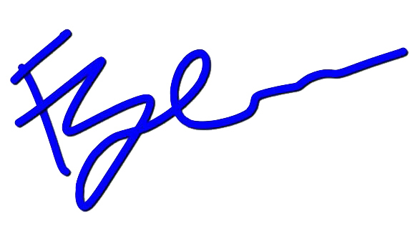
The Gentleman
CONCLUSION
At this point you’ve probably gotten the hang of your new style and sending me all of your new looks and not even reading anymore! That’s exactly what I want! The entire purpose from this all is for you to learn, retain, and become The Gentleman the ladies love. The most important thing that I wanted is for you to see yourself in a different light. Self re-invention is so prevalent to keeping yourself exciting! When you feel better about yourself the energy that you exude is so magnifying.
Wow! It’s good to see you looking as good as you deserve, and feeling better than you look, Gentleman.
With Style,

